Slide 1
A One-way Speed of Light
(Not the Lorentz Transform)
(May induce sleep)
…

Slide 2
Developing The Math
What would a faster than light traveler look like to a stationary observer?
Givens
Light propagates through space at a constant speed
Light originates in space at some point of emission
in some direction
not a sphere, though not to disallow a spherical model because one does not necessarily know which way the photon went)
The direction and speed of the emitter does not change the speed of light
The observer is some distance from the path of the traveler
The observer has perfect stereoscopic vision and can tell direction and distance to an emitted point.

Slide 3
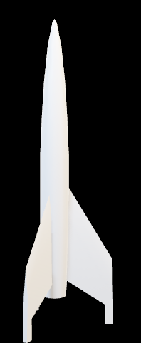




$$VT−L$$
$$VT$$
$$VT+L$$
$$D$$

Slide 4







$$VT−L$$
$$VT$$
$$VT+L$$
$$T_{O}=T_{E}+\frac{\sqrt{D^{2}+{\left(VT_{E}−L\right)}^{2}}}{C}$$
$$T_{O}=T_{E}+\frac{\sqrt{D^{2}+{\left(VT_{E}\right)}^{2}}}{C}$$
$$D$$
$$T_{O}=T_{E}+\frac{\sqrt{D^{2}+{\left(VT_{E}+L\right)}^{2}}}{C}$$

Slide 5
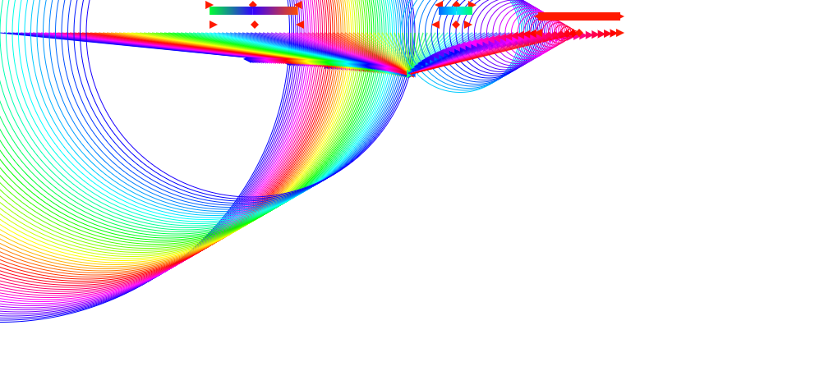

Slide 6



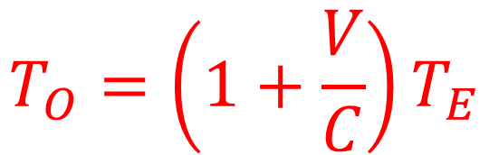


$$T_{O}=T_{E}+\frac{\sqrt{D^{2}+{\left(VT_{E}+L\right)}^{2}}}{C}$$
$$D=0$$
$$L=0$$
$$T_{O}=T_{E}+\frac{\sqrt{{\left(VT_{E}\right)}^{2}}}{C}$$
$$T_{O}=T_{E}+\frac{VT_{E}}{C}$$
$$T_{O}=\left(1+\frac{V}{C}\right)T_{E}$$

Slide 7


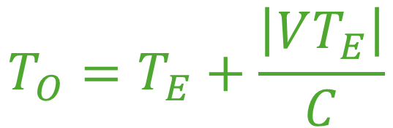


$$T_{O}=T_{E}+\frac{\sqrt{D^{2}+{\left(VT_{E}+L\right)}^{2}}}{C}$$
$$D=0$$
$$L=0$$
$$T_{O}=T_{E}+\frac{\sqrt{{\left(VT_{E}\right)}^{2}}}{C}$$
$$T_{O}=\left(1+\frac{V}{C}\right)T_{E}$$
$$T_{O}=T_{E}+\frac{\left|VT_{E}\right|}{C}$$

Slide 8








Perfect Square Solve
$$ax^{2}+2bx=0$$
$$B=\frac{b}{\sqrt{a}}$$
$$C=\frac{b^{2}}{a}$$
$$A=\sqrt{a}$$
$${\left(Ax+B\right)}^{2}=C$$
$${\left(\sqrt{a}x+\frac{b}{\sqrt{a}}\right)}^{2}=\frac{b^{2}}{a}$$
$$ax^{2}+2\sqrt{a}\frac{b}{\sqrt{a}}x+\frac{b^{2}}{a}=\frac{b^{2}}{a}$$
$$ax^{2}+2bx+\frac{b^{2}}{a}=\frac{b^{2}}{a}$$

Slide 9




$$T_{∆}=\frac{\sqrt{D^{2}+{\left(VT_{E}+L\right)}^{2}}}{C}$$
$$T_{E}=T_{O}−T_{∆}$$
$$T_{∆}=\frac{\sqrt{D^{2}+{\left(V\left(T_{O}−T_{∆}\right)+L\right)}^{2}}}{C}$$
$$T_{∆}=\frac{\sqrt{D^{2}+V^{2}{\left(T_{O}−T_{∆}\right)}^{2}+2VL\left(T_{O}−T_{∆}\right)+L^{2}}}{C}$$
$$C^{2}{T_{∆}}^{2}=D^{2}+V^{2}{\left(T_{O}−T_{∆}\right)}^{2}+2VL\left(T_{O}−T_{∆}\right)+L^{2}$$

Slide 10

$$C^{2}{T_{∆}}^{2}=D^{2}+V^{2}{\left(T_{O}−T_{∆}\right)}^{2}+2VL\left(T_{O}−T_{∆}\right)+L^{2}$$
$$C^{2}{T_{∆}}^{2}=D^{2}+V^{2}{T_{O}}^{2}−2V^{2}T_{O}T_{∆}$$
$+V^{2}{T_{∆}}^{2}+2VLT_{O}−2VLT_{∆}+L^{2}$
$P=$ $D^{2}+V^{2}{T_{O}}^{2}+2VLT_{O}+L^{2}$
$$C^{2}{T_{∆}}^{2}=P−2T_{O}{T_{∆}}^{2}+{V^{2}T_{∆}}^{2}−2VLT_{∆}$$
$$C^{2}{T_{∆}}^{2}−V^{2}{T_{∆}}^{2}+2\left(V^{2}T_{O}T_{∆}+VLT_{∆}\right)=P$$

Slide 11

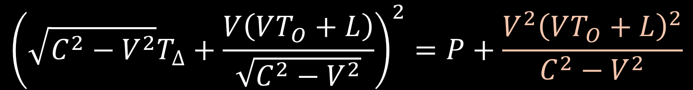
$$C^{2}{T_{∆}}^{2}−V^{2}{T_{∆}}^{2}+2\left(V^{2}T_{O}T_{∆}+VLT_{∆}\right)=P$$
$$\left(C^{2}−V^{2}\right){T_{∆}}^{2}+2VT_{∆}\left(VT_{O}+L\right)=P$$
$${\left(\sqrt{C^{2}−V^{2}}T_{∆}+\frac{V\left(VT_{O}+L\right)}{\sqrt{C^{2}−V^{2}}}\right)}^{2}=P+\frac{V^{2}{\left(VT_{O}+L\right)}^{2}}{C^{2}−V^{2}}$$
$$\sqrt{C^{2}−V^{2}}T_{∆}+\frac{V\left(VT_{O}+L\right)}{\sqrt{C^{2}−V^{2}}}$$
$=±\sqrt{P+\frac{V^{2}V^{2}{T_{O}}^{2}+2V^{2}VT_{O}L+V^{2}L^{2}}{C^{2}−V^{2}}}$

Slide 12


$P=$ $D^{2}+V^{2}{T_{O}}^{2}+2VLT_{O}+L^{2}$
$$\sqrt{C^{2}−V^{2}}T_{∆}+\frac{V\left(VT_{O}+L\right)}{\sqrt{C^{2}−V^{2}}}$$
$=\sqrt{P+\frac{V^{2}V^{2}{T_{O}}^{2}+2V^{2}VT_{O}L+V^{2}L^{2}}{C^{2}−V^{2}}}$
$$\sqrt{C^{2}−V^{2}}T_{∆}+\frac{V\left(VT_{O}+L\right)}{\sqrt{C^{2}−V^{2}}}$$
$=±\sqrt{\frac{\left(C^{2}−V^{2}\right)\left(D^{2}+V^{2}{T_{O}}^{2}+2VLT_{O}+L^{2}\right)}{C^{2}−V^{2}}+\frac{V^{2}V^{2}{T_{O}}^{2}+2V^{2}VT_{O}L+V^{2}L^{2}}{C^{2}−V^{2}}}$

Slide 13
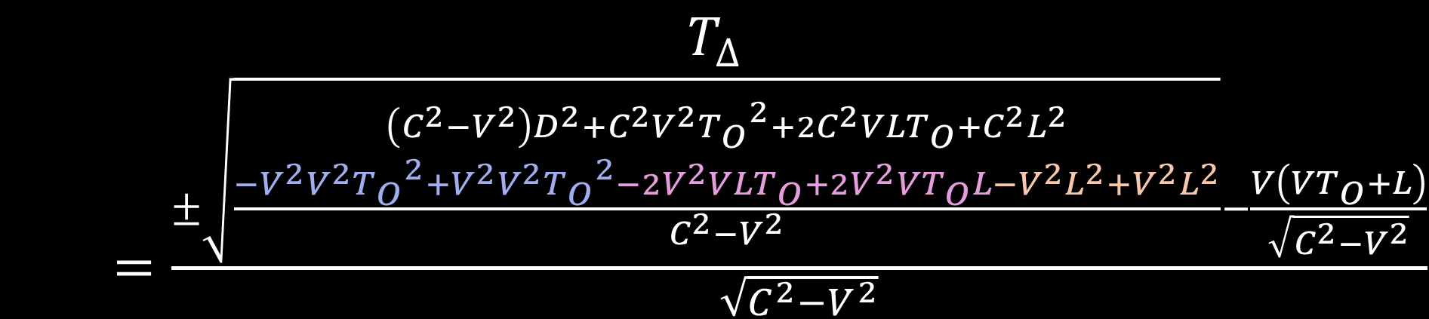

$$\sqrt{C^{2}−V^{2}}T_{∆}+\frac{V\left(VT_{O}+L\right)}{\sqrt{C^{2}−V^{2}}}$$
$=±\sqrt{\frac{\left(C^{2}−V^{2}\right)\left(D^{2}+V^{2}{T_{O}}^{2}+2VLT_{O}+L^{2}\right)}{C^{2}−V^{2}}+\frac{V^{2}V^{2}{T_{O}}^{2}+V^{2}VT_{O}L+V^{2}L^{2}}{C^{2}−V^{2}}}$
$$T_{∆}$$
$=\frac{±\sqrt{\frac{\begin{aligned}\left(C^{2}−V^{2}\right)D^{2}+C^{2}V^{2}{T_{O}}^{2}+2C^{2}VLT_{O}+C^{2}L^{2} \\ −V^{2}V^{2}{T_{O}}^{2}+V^{2}V^{2}{T_{O}}^{2}−2V^{2}VLT_{O}+{2V}^{2}VT_{O}L−V^{2}L^{2}+V^{2}L^{2}\end{aligned}}{C^{2}−V^{2}}}−\frac{V\left(VT_{O}+L\right)}{\sqrt{C^{2}−V^{2}}}}{\sqrt{C^{2}−V^{2}}}$

Slide 14



$$T_{∆}$$
$=\frac{±\sqrt{\frac{\begin{aligned}\left(C^{2}−V^{2}\right)D^{2}+C^{2}V^{2}{T_{O}}^{2}+2C^{2}VLT_{O}+C^{2}L^{2} \\ −V^{2}V^{2}{T_{O}}^{2}+V^{2}V^{2}{T_{O}}^{2}−2V^{2}VLT_{O}+{2V}^{2}VT_{O}L−V^{2}L^{2}+V^{2}L^{2}\end{aligned}}{C^{2}−V^{2}}}−\frac{V\left(VT_{O}+L\right)}{\sqrt{C^{2}−V^{2}}}}{\sqrt{C^{2}−V^{2}}}$
$$T_{∆}=\frac{±\sqrt{\left(C^{2}−V^{2}\right)D^{2}+C^{2}V^{2}{T_{O}}^{2}+2C^{2}VLT_{O}+C^{2}L^{2}}−V\left(VT_{O}+L\right)}{C^{2}−V^{2}}$$
$T_{∆}=$ $\frac{±\sqrt{\left(C^{2}−V^{2}\right)D^{2}+C^{2}{\left(VT_{O}+L\right)}^{2}}−V\left(VT_{O}+L\right)}{C^{2}−V^{2}}$

Slide 15







$T_{∆}=$ $\frac{±\sqrt{\left(C^{2}−V^{2}\right)D^{2}+C^{2}{\left(VT_{O}+L\right)}^{2}}−V\left(VT_{O}+L\right)}{C^{2}−V^{2}}$
The positive solution is good for V<C, the negative solution
should be checked if V>C; $T_{∆}$ must be positive.
$T_{∆}=$ $\frac{±CVT_{O}−V^{2}T_{O}}{C^{2}−V^{2}}$
FTL?
$T_{∆}=$ $\frac{VT_{O}}{C+V}$
Sublight?
$T_{∆}=$ $−\frac{VT_{O}}{C−V}$
$T_{∆}=$ $\frac{\left(C−V\right)VT_{O}}{C^{2}−V^{2}}$
$T_{∆}=$ $\frac{−(C+V)VT_{O}}{C^{2}−V^{2}}$

Slide 16





$$T_{∆}=\frac{\sqrt{D^{2}+{\left(C\left(T_{O}−T_{∆}\right)+L\right)}^{2}}}{C}$$
$C^{2}{T_{∆}}^{2}=$ $D^{2}+$ $C^{2}{\left(T_{O}−T_{∆}\right)}^{2}+2CL\left(CT_{O}−CT_{∆}\right)+L^{2}$
$C^{2}{T_{∆}}^{2}=$ $D^{2}+$ $C^{2}{T_{O}}^{2}−2C^{2}T_{O}T_{∆}+C^{2}{T_{∆}}^{2}$
$$+2CLT_{O}−2CLT_{∆}+L^{2}$$
$C^{2}{T_{∆}}^{2}−C^{2}{T_{∆}}^{2}+\left(2CL+2C^{2}T_{O}\right)T_{∆}=$ $D^{2}+$ $C^{2}{T_{O}}^{2}$
$$+2CLT_{O}+L^{2}$$
$T_{∆}=$ $\frac{D^{2}+ {\left(CT_{O}+L\right)}^{2}}{\left(2CL+2C^{2}T_{O}\right)}$
$T_{∆}=$ $\frac{D^{2}+ {\left(CT_{O}+L\right)}^{2}}{2C\left(CT_{O}+L\right)}$

Slide 17









$$T_{E}=T_{O}−\frac{D^{2}+{\left(CT_{O}+L\right)}^{2}}{\left(2CL+2C^{2}T_{O}\right)}$$
$T_{∆}=$ $\frac{D^{2}+ {\left(CT_{O}+L\right)}^{2}}{\left(2CL+2C^{2}T_{O}\right)}$
$T_{∆}=$ $\frac{ {\left(CT_{O}\right)}^{2}}{\left(2C^{2}T_{O}\right)}$
$$T_{E}=\frac{T_{O}\left(2CL+2C^{2}T_{O}\right)−D^{2}−{\left(CT_{O}+L\right)}^{2}}{\left(2CL+2C^{2}T_{O}\right)}$$
$T_{∆}=$ $\frac{T_{O}}{2}$
$$T_{E}=\frac{C^{2}{T_{O}}^{2}−D^{2}−L^{2}}{\left(2CL+2C^{2}T_{O}\right)}$$
$T_{E}=$ $T_{O}−\frac{T_{O}}{2}$
$T_{E}=$ $\frac{T_{O}}{2}$
$T_{E}=$ $\frac{T_{O}}{2}$

Slide 18
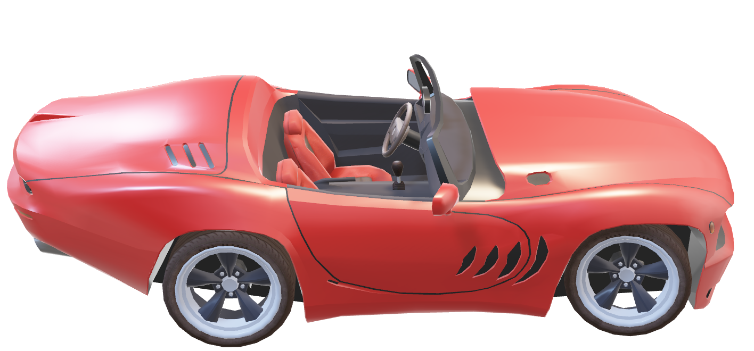

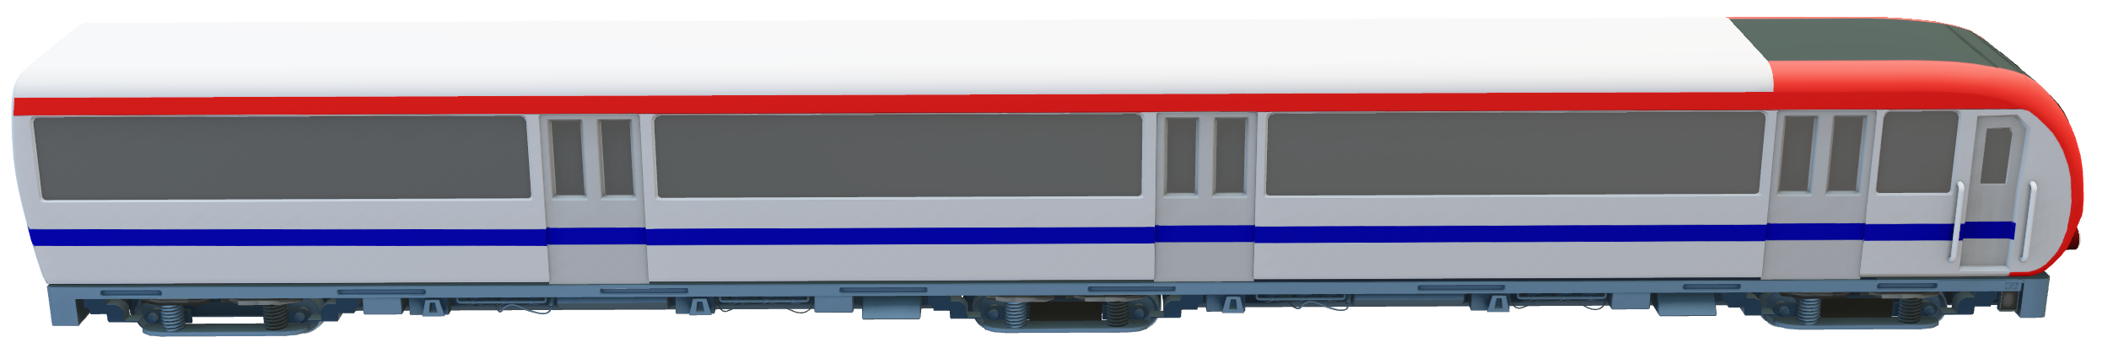
Relative Velocity
55
65
-10?
10?
What about when the car is at the driver? 0mph?

Slide 19
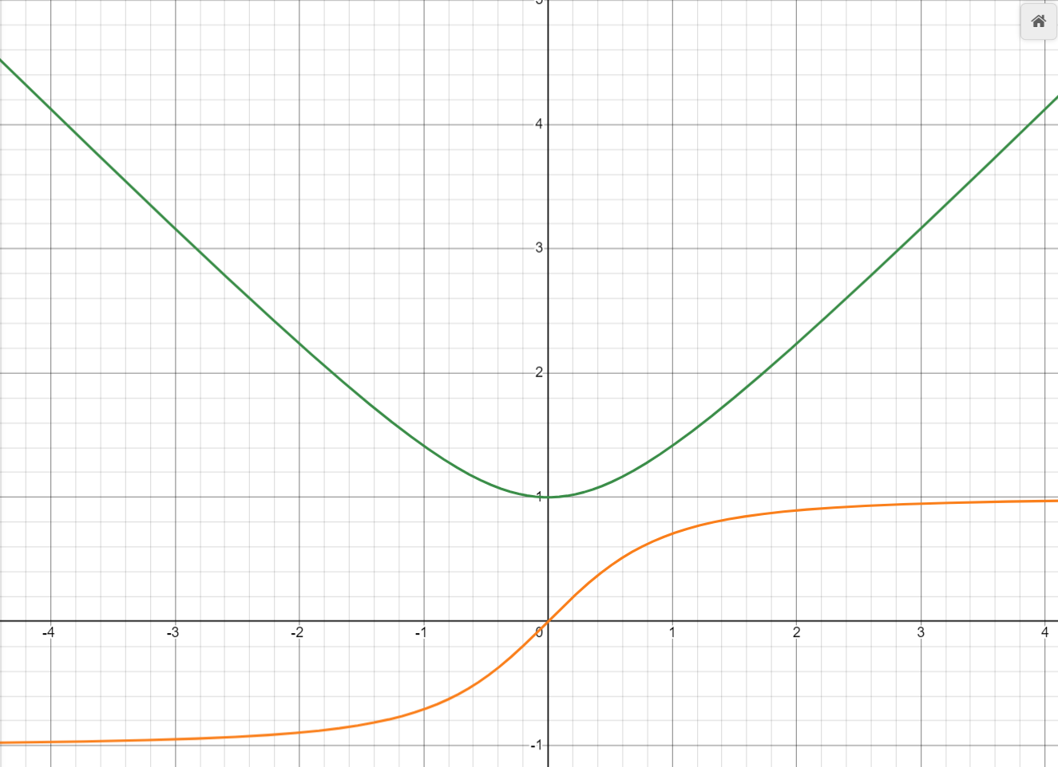
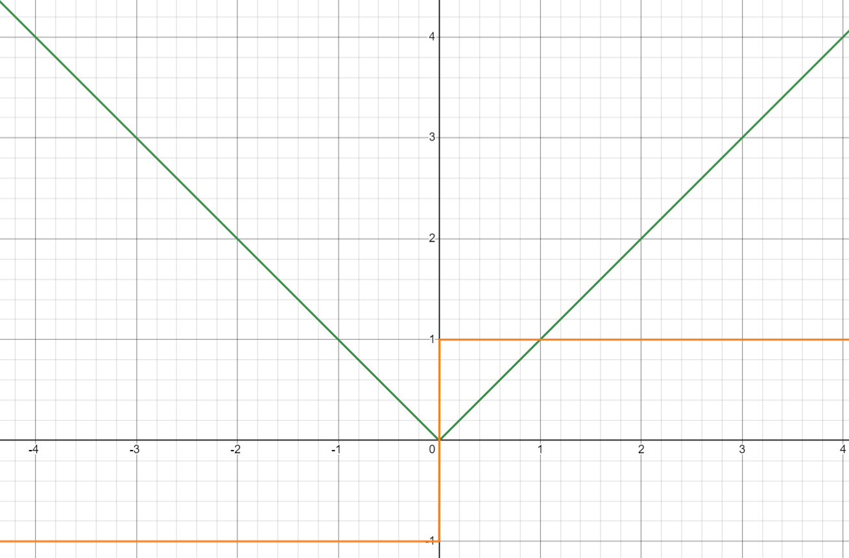




https://www.desmos.com/calculator/pnc4xaqpk0
Distance 1, Velocity 1
Distance 0, Velocity 1
$$R_{P}\left(t\right)=\left\|\vec{\{0,D,0\}}+\vec{\{V,0,0\}}t\right\|$$
$$R_{P}\left(t\right)=\sqrt{D^{2}+V^{2}t^{2}}$$
$$R_{V}\left(t\right)=\frac{V^{2}}{\sqrt{D^{2}+V^{2}t^{2}}}$$
$$R_{P}\left(t\right)=\left\|\vec{D}+\vec{V}t\right\|$$
Notes:
https://www.desmos.com/calculator/pnc4xaqpk0

Slide 20








Vector Math
$$\vec{V}=\left\{x,y,z,…\right\}$$
$$\left\|\vec{V}\right\|=\sqrt{x^{2}+y^{2}+z^{2}+…}$$
$$\vec{V}∙\vec{V}=xx+yy+zz+…$$
$$\vec{V}∙\vec{V}=x^{2}+y^{2}+z^{2}+…$$
$$\left\|\vec{V}\right\|=\sqrt{\vec{V}∙\vec{V}}$$
$\vec{V_{1}}+\vec{V_{2}}=$ $\left\{x_{1}+x_{2},y_{1}+y_{2},z_{1}+z_{2},…\right\}$
$${\vec{V}}^{2}=\vec{V}∙\vec{V}$$
$\vec{V_{1}}−\vec{V_{2}}=$ $\left\{x_{1}−x_{2},y_{1}−y_{2},z_{1}−z_{2},…\right\}$
$$\left\|\vec{V}\right\|=\sqrt{{\vec{V}}^{2}}$$
$\vec{V}T=$ $\left\{xT,yT,zT,…\right\}$

Slide 21
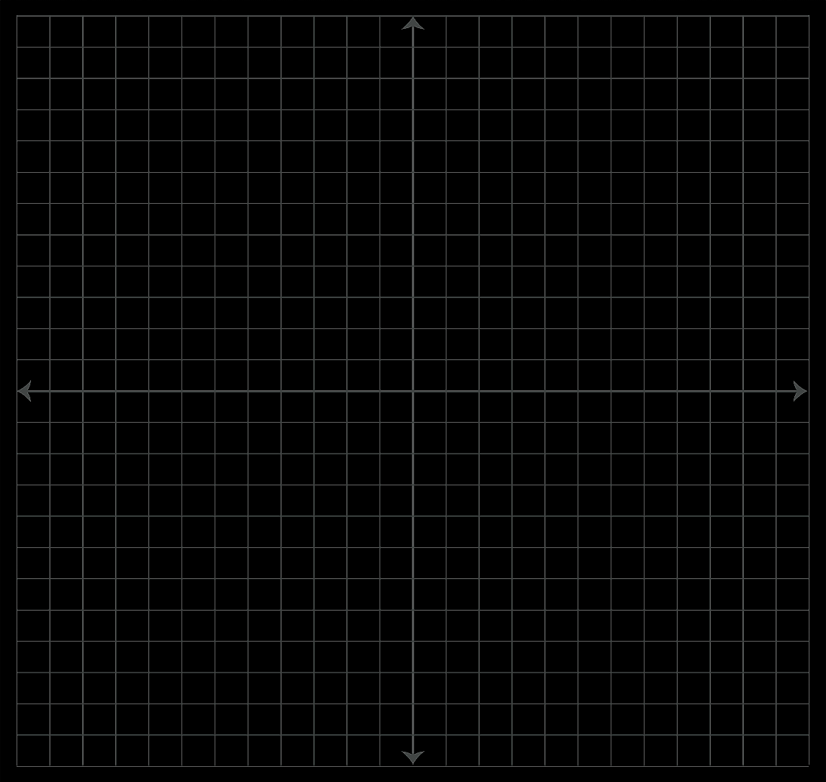


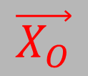

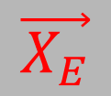


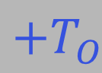
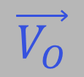

$$\vec{V_{E}}$$
$$+T_{E}$$
$$\vec{X_{E}}$$
$$−T_{E}$$
$$\vec{X_{O}}$$
$$−T_{O}$$
$$\vec{V_{O}}$$
$$\vec{X_{E}}+\vec{V_{E}}T_{E}$$
$$\vec{X_{O}}+\vec{V_{O}}T_{O}$$
$$+T_{O}$$

Slide 22




3D Math
$$T_{O}=T_{E}+\frac{\left\|\left(\vec{X_{E}}+\vec{V_{E}}T_{E}\right)−\left(\vec{X_{O}}+\vec{V_{O}}T_{O}\right)\right\| }{C}$$
$$T_{O}=T_{E}+\frac{\sqrt{{\left(\left(\vec{X_{E}}+\vec{V_{E}}T_{E}\right)−\left(\vec{X_{O}}+\vec{V_{O}}T_{O}\right)\right)}^{2}}}{C}$$
$$P=\left(\vec{X_{E}}\right)−\left(\vec{X_{O}}+\vec{V_{O}}T_{O}\right)$$
$$T_{O}=T_{E}+\frac{\sqrt{{\left(P+\vec{V_{E}}T_{E}\right)}^{2}}}{C}$$

Slide 23


$$T_{O}=T_{E}+\frac{\sqrt{{\left(P+\vec{V_{E}}T_{E}\right)}^{2}}}{C}$$
$$C\left(T_{O}−T_{E}\right)=\sqrt{{\left(P+\vec{V_{E}}T_{E}\right)}^{2}}$$
$$C^{2}{\left(T_{O}−T_{E}\right)}^{2}=P^{2}+2P\vec{V_{E}}T_{E}+{\vec{V_{E}}}^{2}{T_{E}}^{2}$$
$$C^{2}{T_{O}}^{2}−2C^{2}T_{O}T_{E}+C^{2}{T_{E}}^{2}=P^{2}+2P\vec{V_{E}}T_{E}+{\vec{V_{E}}}^{2}{T_{E}}^{2}$$
$$C^{2}{T_{E}}^{2}−{\vec{V_{E}}}^{2}{T_{E}}^{2}−2C^{2}T_{O}T_{E}−2P\vec{V_{E}}T_{E}=P^{2}−C^{2}{T_{O}}^{2}$$
$$\left(C^{2}−{\vec{V_{E}}}^{2}\right){T_{E}}^{2}−2\left(C^{2}T_{O}+P\vec{V_{E}}\right)T_{E}=P^{2}−C^{2}{T_{O}}^{2}$$
Notes:
… Which leads to the hard part…

Slide 24

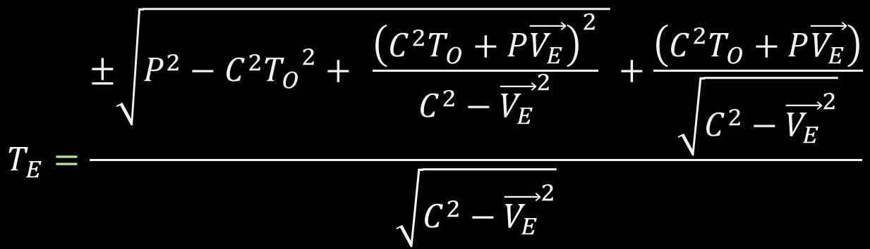

$$\left(C^{2}−{\vec{V_{E}}}^{2}\right){T_{E}}^{2}−2\left(C^{2}T_{O}+P\vec{V_{E}}\right)T_{E}=P^{2}−C^{2}{T_{O}}^{2}$$
${\left(\sqrt{C^{2}−{\vec{V_{E}}}^{2}}T_{E}−\frac{\left(C^{2}T_{O}+P\vec{V_{E}}\right)}{\sqrt{C^{2}−{\vec{V_{E}}}^{2}}}\right)}^{2}=P^{2}−C^{2}{T_{O}}^{2}+$ $\frac{{\left(C^{2}T_{O}+P\vec{V_{E}}\right)}^{2}}{C^{2}−{\vec{V_{E}}}^{2}}$
$$\sqrt{C^{2}−{\vec{V_{E}}}^{2}}T_{E}−\frac{\left(C^{2}T_{O}+P\vec{V_{E}}\right)}{\sqrt{C^{2}−{\vec{V_{E}}}^{2}}}=±\sqrt{P^{2}−C^{2}{T_{O}}^{2}+ \frac{{\left(C^{2}T_{O}+P\vec{V_{E}}\right)}^{2}}{C^{2}−{\vec{V_{E}}}^{2}} }$$
$$T_{E}=\frac{±\sqrt{P^{2}−C^{2}{T_{O}}^{2}+ \frac{{\left(C^{2}T_{O}+P\vec{V_{E}}\right)}^{2}}{C^{2}−{\vec{V_{E}}}^{2}} }+\frac{\left(C^{2}T_{O}+P\vec{V_{E}}\right)}{\sqrt{C^{2}−{\vec{V_{E}}}^{2}}}}{\sqrt{C^{2}−{\vec{V_{E}}}^{2}}}$$

Slide 25
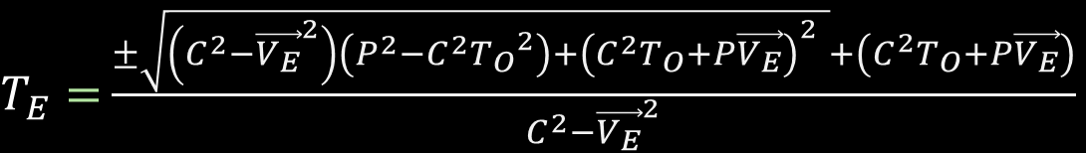

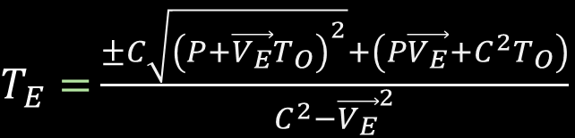
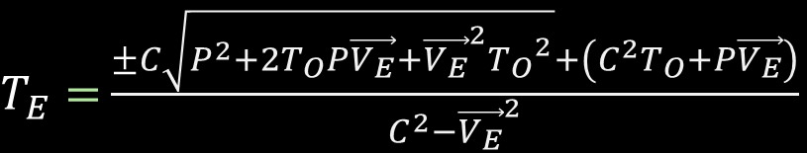
$$T_{E}=\frac{±\sqrt{P^{2}−C^{2}{T_{O}}^{2}+ \frac{{\left(C^{2}T_{O}+P\vec{V_{E}}\right)}^{2}}{C^{2}−{\vec{V_{E}}}^{2}} }+\frac{\left(C^{2}T_{O}+P\vec{V_{E}}\right)}{\sqrt{C^{2}−{\vec{V_{E}}}^{2}}}}{\sqrt{C^{2}−{\vec{V_{E}}}^{2}}}$$
$T_{E}=$ $\frac{±\sqrt{\left(C^{2}−{\vec{V_{E}}}^{2}\right)\left(P^{2}−C^{2}{T_{O}}^{2}\right)+{\left(C^{2}T_{O}+P\vec{V_{E}}\right)}^{2} }+\left(C^{2}T_{O}+P\vec{V_{E}}\right)}{C^{2}−{\vec{V_{E}}}^{2}}$
$T_{E}=$ $\frac{±\sqrt{C^{2}P^{2}−{\vec{V_{E}}}^{2}P^{2}{−C}^{2}C^{2}{T_{O}}^{2}+{\vec{V_{E}}}^{2}C^{2}{T_{O}}^{2}+C^{2}T_{O}C^{2}T_{O}+2C^{2}T_{O}P\vec{V_{E}}+P\vec{V_{E}}P\vec{V_{E}} }+\left(C^{2}T_{O}+P\vec{V_{E}}\right)}{C^{2}−{\vec{V_{E}}}^{2}}$
$T_{E}=$ $\frac{±C\sqrt{P^{2}+2T_{O}P\vec{V_{E}}+{\vec{V_{E}}}^{2}{T_{O}}^{2}}+\left(C^{2}T_{O}+P\vec{V_{E}}\right)}{C^{2}−{\vec{V_{E}}}^{2}}$
$T_{E}=$ $\frac{±C\sqrt{{\left(P+\vec{V_{E}}T_{O}\right)}^{2}}+\left(P\vec{V_{E}}+C^{2}T_{O}\right)}{C^{2}−{\vec{V_{E}}}^{2}}$

Slide 26



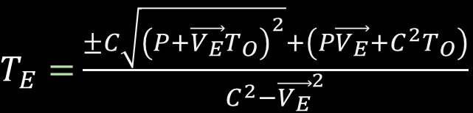


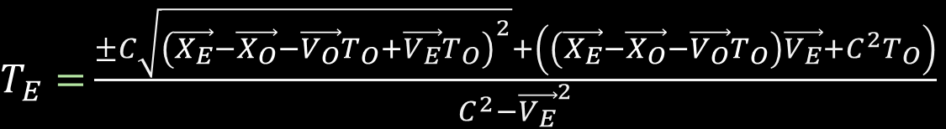
$T_{E}=$ $\frac{±C\sqrt{{\left(P+\vec{V_{E}}T_{O}\right)}^{2}}+\left(P\vec{V_{E}}+C^{2}T_{O}\right)}{C^{2}−{\vec{V_{E}}}^{2}}$
$$P=\left(\vec{X_{E}}\right)−\left(\vec{X_{O}}+\vec{V_{O}}T_{O}\right)$$
$T_{E}=$ $\frac{±C\sqrt{{\left(\vec{X_{E}}−\vec{X_{O}}−\vec{V_{O}}T_{O}+\vec{V_{E}}T_{O}\right)}^{2}}+\left(\left(\vec{X_{E}}−\vec{X_{O}}−\vec{V_{O}}T_{O}\right)\vec{V_{E}}+C^{2}T_{O}\right)}{C^{2}−{\vec{V_{E}}}^{2}}$
$T_{E}=$ $\frac{−C\sqrt{{\left(\vec{X_{E}}−\vec{X_{O}}+\left(\vec{V_{E}}−\vec{V_{O}}\right)T_{O}\right)}^{2}}+\left(\vec{X_{E}}−\vec{X_{O}}\right)\vec{V_{E}}+\left(C^{2}−\vec{V_{O}}\vec{V_{E}}\right)T_{O}}{C^{2}−{\vec{V_{E}}}^{2}}$
$$V<C$$
$T_{E}=$ $\frac{C\sqrt{{\left(\vec{X_{E}}−\vec{X_{O}}+\left(\vec{V_{E}}−\vec{V_{O}}\right)T_{O}\right)}^{2}}+\left(\vec{X_{E}}−\vec{X_{O}}\right)\vec{V_{E}}+\left(C^{2}−\vec{V_{O}}\vec{V_{E}}\right)T_{O}}{C^{2}−{\vec{V_{E}}}^{2}}$
$$V>C$$
If (Te < To) then the result is valid…

Slide 27









$$T_{O}=T_{E}+\frac{\sqrt{{\left(\left(\vec{X_{E}}+\vec{V_{E}}T_{E}\right)−\left(\vec{X_{O}}+\vec{V_{O}}T_{O}\right)\right)}^{2}}}{C}$$
$$V_{E}=C$$
$$T_{O}=T_{E}+\frac{\sqrt{{\left(\left(\vec{X_{E}}+\vec{V_{E}}T_{E}\right)−\left(\vec{X_{O}}+\vec{V_{O}}T_{O}\right)\right)}^{2}}}{\vec{V_{E}}}$$
$$\sqrt{{\vec{V_{E}}}^{2}}\left(T_{O}−T_{E}\right)=\sqrt{P^{2}+2P\vec{V_{E}}T_{E}+C^{2}{T_{E}}^{2}}$$
$$P=\left(\vec{X_{E}}\right)−\left(\vec{X_{O}}+\vec{V_{O}}T_{O}\right)$$
$${\vec{V_{E}}}^{2}{T_{O}}^{2}−2{\vec{V_{E}}}^{2}T_{O}T_{E}+{\vec{V_{E}}}^{2}{T_{E}}^{2}=P^{2}+2P\vec{V_{E}}T_{E}+{\vec{V_{E}}}^{2}{T_{E}}^{2}$$
$$T_{O}=T_{E}+\frac{\sqrt{{\left(P+\vec{V_{E}}T_{E}\right)}^{2}}}{\sqrt{{\vec{V_{E}}}^{2}}}$$
$$−2{\vec{V_{E}}}^{2}T_{O}T_{E}−2P\vec{V_{E}}T_{E}=P^{2}−{\vec{V_{E}}}^{2}{T_{O}}^{2}$$
$$T_{E}=\frac{P^{2}−{\vec{V_{E}}}^{2}{T_{O}}^{2}}{−2\left({\vec{V_{E}}}^{2}T_{O}+P\vec{V_{E}}\right)}$$
$$T_{O}=T_{E}+\frac{\sqrt{P^{2}+2P\vec{V_{E}}T_{E}+{\vec{V_{E}}}^{2}{T_{E}}^{2}}}{\sqrt{{\vec{V_{E}}}^{2}}}$$
$$T_{E}=\frac{{\left(\left(\vec{X_{E}}\right)−\left(\vec{X_{O}}+\vec{V_{O}}T_{O}\right)\right)}^{2}−{\vec{V_{E}}}^{2}{T_{O}}^{2}}{−2\left({\vec{V_{E}}}^{2}T_{O}+\left(\left(\vec{X_{E}}\right)−\left(\vec{X_{O}}+\vec{V_{O}}T_{O}\right)\right)\vec{V_{E}}\right)}$$

Slide 28


$$T_{E}=\frac{{\left(\left(\vec{X_{E}}\right)−\left(\vec{X_{O}}+\vec{V_{O}}T_{O}\right)\right)}^{2}−{\vec{V_{E}}}^{2}{T_{O}}^{2}}{−2\left({\vec{V_{E}}}^{2}T_{O}+\left(\left(\vec{X_{E}}\right)−\left(\vec{X_{O}}+\vec{V_{O}}T_{O}\right)\right)\vec{V_{E}}\right)}$$
$$T_{E}=\frac{{\left(\left(\vec{X_{E}}\right)−\left(\vec{X_{O}}+\vec{V_{O}}T_{O}\right)\right)}^{2}−C^{2}{T_{O}}^{2}}{−2\left(C^{2}T_{O}+\left(\left(\vec{X_{E}}\right)−\left(\vec{X_{O}}+\vec{V_{O}}T_{O}\right)\right)\vec{V_{E}}\right)}$$

Slide 29



A Different $C$ Constant
$$C=\frac{distance}{time unit}$$
Velocity
Distance
$$C_{L}=C∙1\left(time units\right)$$

Slide 30
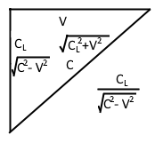






Setup for Length Contraction
$$\frac{C_{L}}{C−V}$$
$$C−V$$
$$\sqrt{C^{2}−V^{2}}$$
$\frac{C_{L}}{\sqrt{C^{2}−V^{2}}}$ (time)
$$\frac{C_{L}}{C+V}$$
$$C+V$$

Slide 31
This is not about why length contraction happens; just how it gets derived from the math.
There was an explanation I saw not so long ago, and cannot find, that had a good visualization.
It has to do with the exchange between electrostatic and electromagnetic phases, and two-way travel being limited to a certain amount of time, which in turn restricts the maximum distance fields can propagate.
$T_{E}=$ $\frac{−C^{2}T_{O}}{C^{2}−{\vec{V_{O}}}^{2}}$

Slide 32

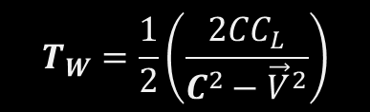

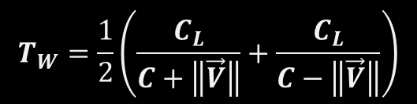
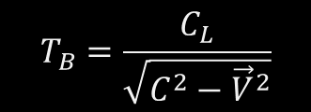

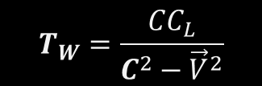
Length Contraction
$$T_{W}=\frac{1}{2}\left(\frac{C_{L}}{C+\left\|\vec{V}\right\|}+\frac{C_{L}}{C−\left\|\vec{V}\right\|}\right)$$
$$T_{B}=\frac{C_{L}}{\sqrt{C^{2}−{\vec{V}}^{2}}}$$
$$T_{W}=\frac{1}{2}\left(\frac{2CC_{L}}{C^{2}−{\vec{V}}^{2}}\right)$$
$$\frac{T_{B}}{T_{W}}=\frac{\frac{C_{L}}{\sqrt{C^{2}−{\vec{V}}^{2}}}}{\frac{CC_{L}}{C^{2}−{\vec{V}}^{2}}}=\frac{C_{L}}{\sqrt{C^{2}−{\vec{V}}^{2}}}\frac{C^{2}−{\vec{V}}^{2}}{CC_{L}}$$
$$T_{W}=\frac{CC_{L}}{C^{2}−{\vec{V}}^{2}}$$
$$Γ=\frac{T_{B}}{T_{W}}=\frac{\sqrt{C^{2}−{\vec{V}}^{2}}}{C}=\sqrt{1−\frac{{\vec{V}}^{2}}{C^{2}}}$$
$$γ=\frac{1}{Γ}$$

Slide 33
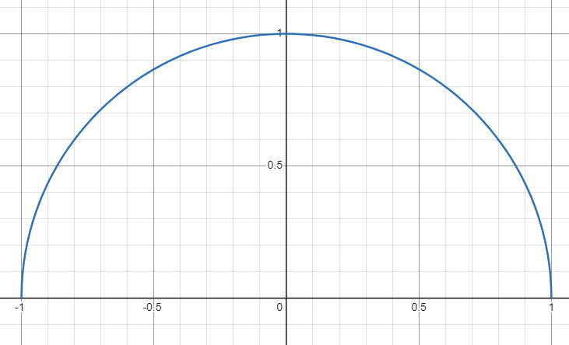

$$\frac{\sqrt{C^{2}−x^{2}}}{C}$$

Slide 34
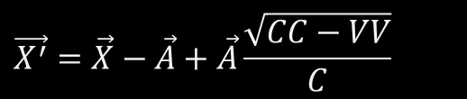
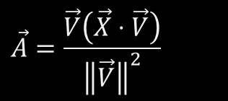
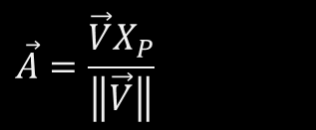
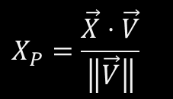
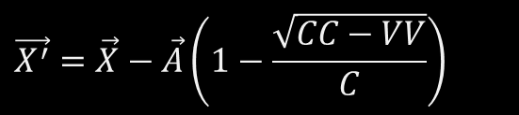
Applied Length Contraction Along Velocity
$$X_{P}=\frac{\vec{X}⋅\vec{V}}{\left\|\vec{V}\right\|}$$
$$\vec{A}=\frac{\vec{V}X_{P}}{\left\|\vec{V}\right\|}$$
$$\vec{A}=\frac{\vec{V}\left(\vec{X}⋅\vec{V}\right)}{{\left\|\vec{V}\right\|}^{2}}$$
$$\vec{X^{′}}=\vec{X}−\vec{A}+\vec{A}\frac{\sqrt{CC−VV}}{C}$$
$$\vec{X^{′}}=\vec{X}−\vec{A}\left(1−\frac{\sqrt{CC−VV}}{C}\right)$$

Slide 35
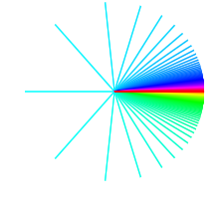
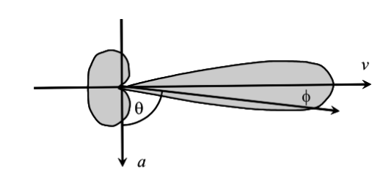
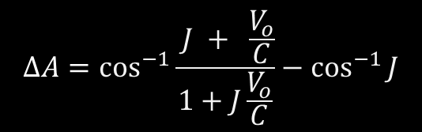
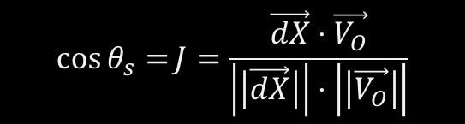

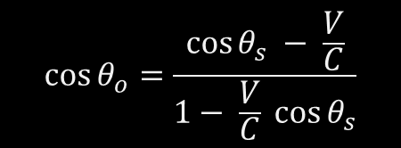
Light Aberration
$$\cos{θ_{o}}=\frac{\cos{θ_{s}} − \frac{V}{C}}{1− \frac{V}{C} \cos{θ_{s}}}$$
$$\vec{dX}=\left(\vec{X_{E}}−\vec{X_{O}}\right)$$
$$\cos{θ_{s}=}J=\frac{\vec{dX}⋅\vec{V_{O}}}{\left|\left|\vec{dX}\right|\right|⋅\left|\left|\vec{V_{O}}\right|\right|}$$
$$ΔA=\cos^{−1}{\frac{ J + \frac{V_{o}}{C}}{1+J\frac{V_{o}}{C}}}−\cos^{−1}{J}$$

Slide 36
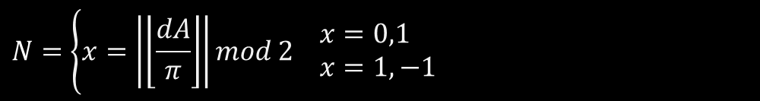


$$dA=D−A$$
$$N=\left\{x=\left|\left\lfloor \frac{dA}{π}\right\rfloor \right|mod 2 \begin{aligned}& x=0,1 \\ & x=1,−1\end{aligned}\right.$$
$$b=N∗\cos^{−1}{\frac{V−C\cos{dA}}{V\cos{dA}−C}}+D$$

Slide 37

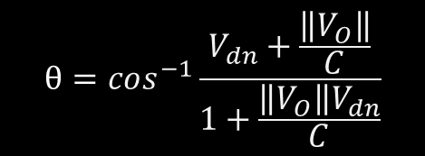

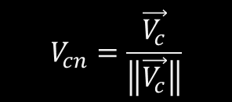

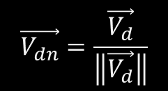
$$\vec{ΔX_{d}}=\vec{X}−\vec{X_{O}}$$
$$V_{cn}=\frac{\vec{V_{c}}}{\left\|\vec{V_{c}}\right\|}$$
$$\vec{V_{dn}}=\frac{\vec{V_{d}}}{\left\|\vec{V_{d}}\right\|}$$
$$\vec{V_{c}}=\vec{ΔX_{d}}×\vec{V_{O}}$$
$$\vec{V_{d}}=\vec{ΔX_{d}}⋅\vec{V_{O}}$$
(velocity cross delta position)
(velocity dot delta position)
$$θ=cos^{−1}\frac{V_{dn}+\frac{\left\|V_{O}\right\|}{C}}{1+\frac{\left\|V_{O}\right\|V_{dn}}{C}}$$
$$\vec{X_{r}}=\vec{X_{O}}+\cos\left(θ\right)\vec{ΔX_{d}}+\sin\left(θ\right)\left(\vec{V_{C}}×\vec{ΔX_{d}}\right)+\left(\left(1−\cos{θ}\right)\vec{V_{c}}⋅\vec{ΔX_{d}}\right)\vec{ΔV_{cn}}$$

Slide 38
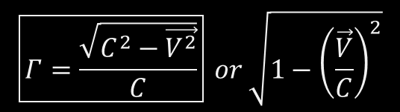

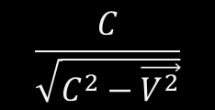
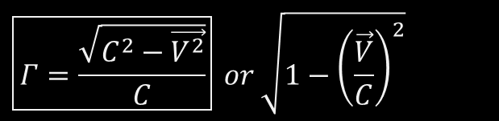
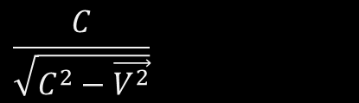
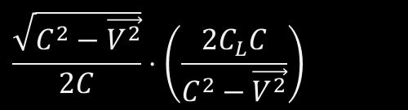
Time Contraction
$$T_{W}=\frac{1}{2}∙\frac{\sqrt{C^{2}−V^{2}}}{C}\left(\frac{C_{L}}{\left(C+V\right)}+\frac{C_{L}}{\left(C−V\right)}\right)$$
$$\frac{\sqrt{C^{2}−\vec{V^{2}}}}{2C}⋅\left(\frac{2C_{L}C}{C^{2}−\vec{V^{2}}}\right)$$
$$\frac{C}{\sqrt{C^{2}−\vec{V^{2}}}}$$
$$\frac{C}{\sqrt{C^{2}−\vec{V^{2}}}}$$
$$\boxed{Γ=\frac{\sqrt{C^{2}−\vec{V^{2}}}}{C}} or \sqrt{1−{\left(\frac{\vec{V}}{C}\right)}^{2}}$$
$$\boxed{Γ=\frac{\sqrt{C^{2}−\vec{V^{2}}}}{C}} or \sqrt{1−{\left(\frac{\vec{V}}{C}\right)}^{2}}$$

Slide 39
https://d3x0r.github.io/STFRPhysics/math/indexLightSpeed.html
https://d3x0r.github.io/STFRPhysics/math/indexLightSpeed1.html
https://d3x0r.github.io/STFRPhysics/math/indexLightSpeed2a.html
https://d3x0r.github.io/STFRPhysics/math/indexLightSpeed3b.html
https://d3x0r.github.io/Voxelarium.js/index2-dual-view.html
https://d3x0r.github.io/STFRPhysics/math/indexLightSpeed4.html
https://d3x0r.github.io/STFRPhysics/math/indexInterferometer4.html

Slide 40
https://d3x0r.github.io/STFRPhysics/math/indexLightSpeed-Clocks.html
https://d3x0r.github.io/STFRPhysics/math/indexLightSpeed4-wheel.html

Slide 41
www.youtube.com/user/3zdayz (J Decker)
www.youtube.com/@3zdayz/videos
www.github.com/d3x0r (Jim B)
www.github.com/d3x0r/STFRPhysics

